Slide 1
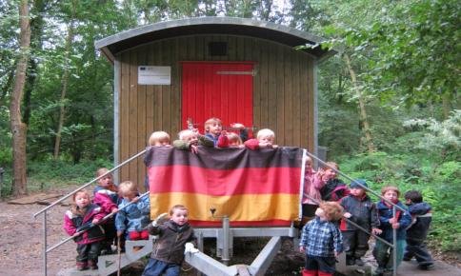
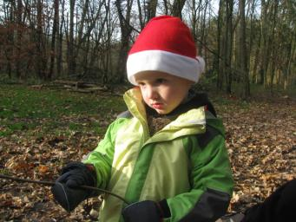
Christmas customs in Germany

Slide 2
The christmas tree

Slide 3
Everywhere in the city, there are christmas trees. Next to the 24 december every family decorate a christmas tree at home.

Slide 4
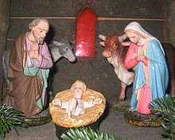
The crip
At home we decorate a crib. On the 24. december the figure of Jesus will be put into the manger. Into churches are cribs too.

Slide 5
Santa Claus

Slide 6
On the 6 of december Santa Claus will come to the children at night. The children clean their shoes and put these outside the door. Santa will put sweets inside.

Slide 7
Christmas singing

Slide 8
At schools, kindergartens, on market places into churches many childern and choirs sing christmas songs.

Slide 9
The „Christkind“

Slide 10
The “Christkind“ in Germany is a girl with an angel like costume. We meet on christmas market.

Slide 11
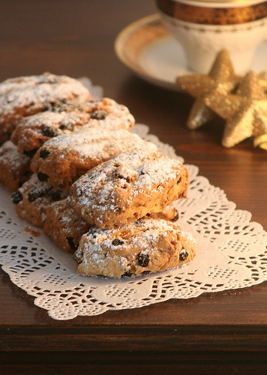
The christmas bakery
At home and at kindergarten we bake many cakes and other christmas sweets.

Slide 12
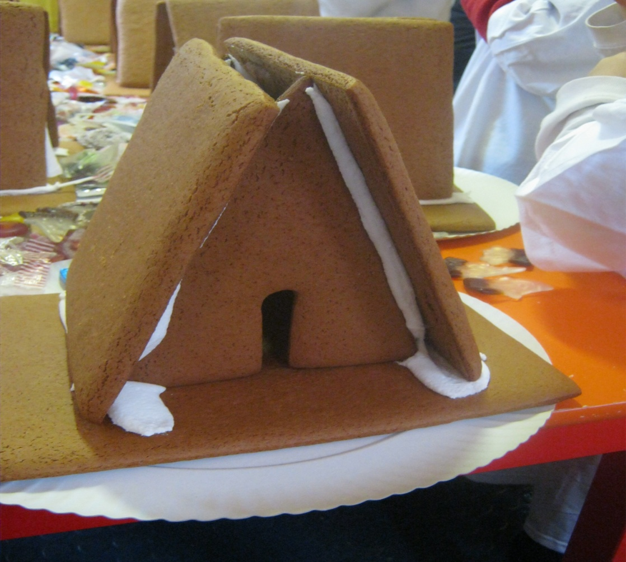
Our witch house

Slide 13
